Slide 1


Research on Digital Revenue
Oct 10, 2019

Slide 2
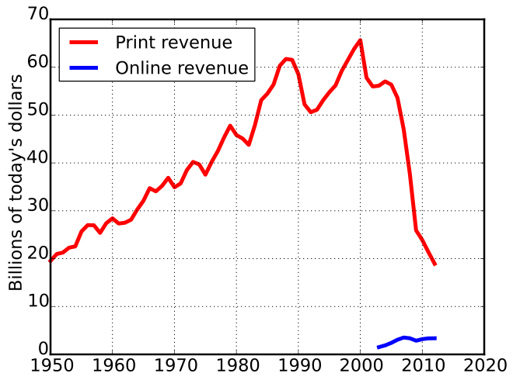

Slide 3
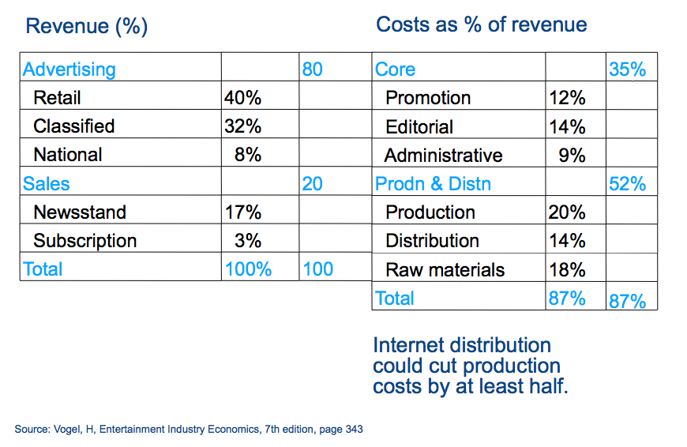

Slide 4
Traditional News
Business Model
Emerging News
Business Model
Subscription
Advertising
Advertising
Subscription

Slide 5
Traditional News
Business Model
Emerging News
Business Model
Subscription
Advertising

Slide 6
Build A Habit of News.

Slide 7
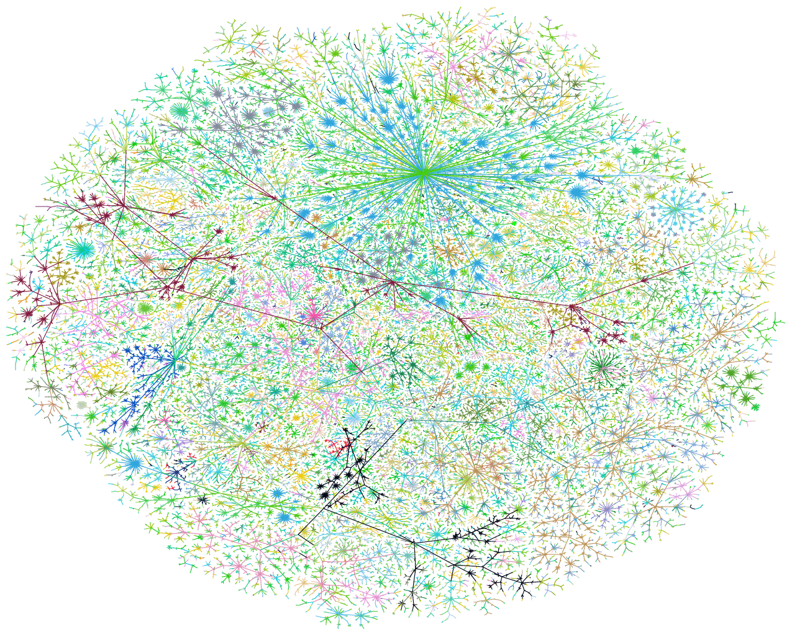

Slide 8
How do you build a habit?
Know Your People
Serve targeted audiences with targeted content
Funnel occasional users to habitual and paying loyalists
Email, email, email

Slide 9
How do you monetize a habit?
Meter conversion
Email ”conversion campaigns”

Slide 10
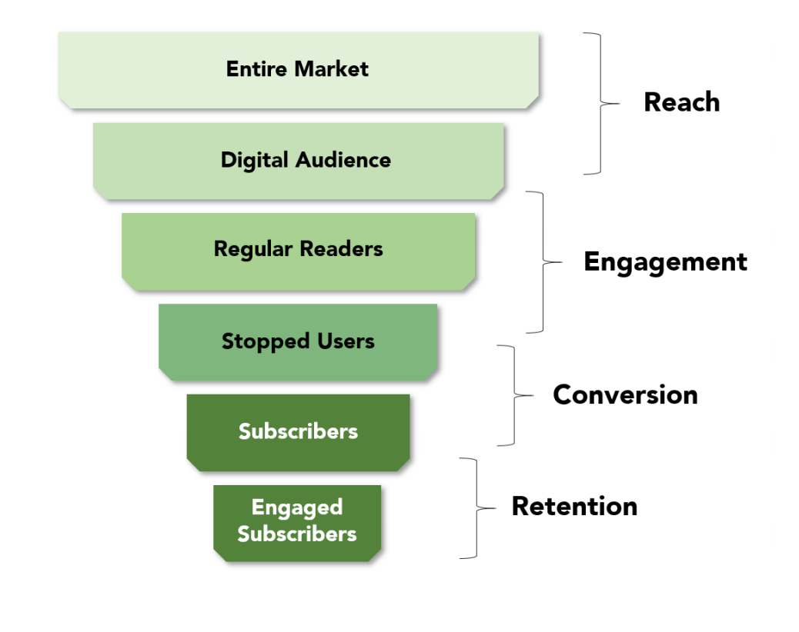

Slide 11
EMAIL

Slide 12
Performance Funnel
Traffic
Prospect
Acquisition
Engagement
Activation
New Subscriber
Organic Search
(Google, Yahoo, Bing)
Paid Search
(Google AdWords)
Submit
Webform
Cross-linking & Content
(Partners, associations, articles)
Landing
Page
Scoring
Engagement action
Social Media
Social Networks
(Facebook, Blogs, Twitter)
Micro
sites
Nurturing
Subscriber
Download
Email / Phone
Email
(regular, tested communications)
Web
site
Conversion
Webinar/
Demo
Direct Visitors
(Business cards, events, splash)
Offline Promotion
(Mail, radio, print)
Click-Through
(Leakage Point #1)
Call to Action
(Leakage Point #2)
Initial Contact
(Leakage Point #3)
Conversion
(Leakage Point #4)
Low organic ranking
Ineffective paid ad copy
Wrong keywords
Sub optimal bid strategy
Email content not compelling
Offer not relevant to needs
Confusing value proposition
Ineffective call to action
Response time too long
Impersonal response
Offer not tailored to online behavior
Lack of focus on priority opportunities
Failure to understand and overcome objections
“Just not ready”

Slide 13
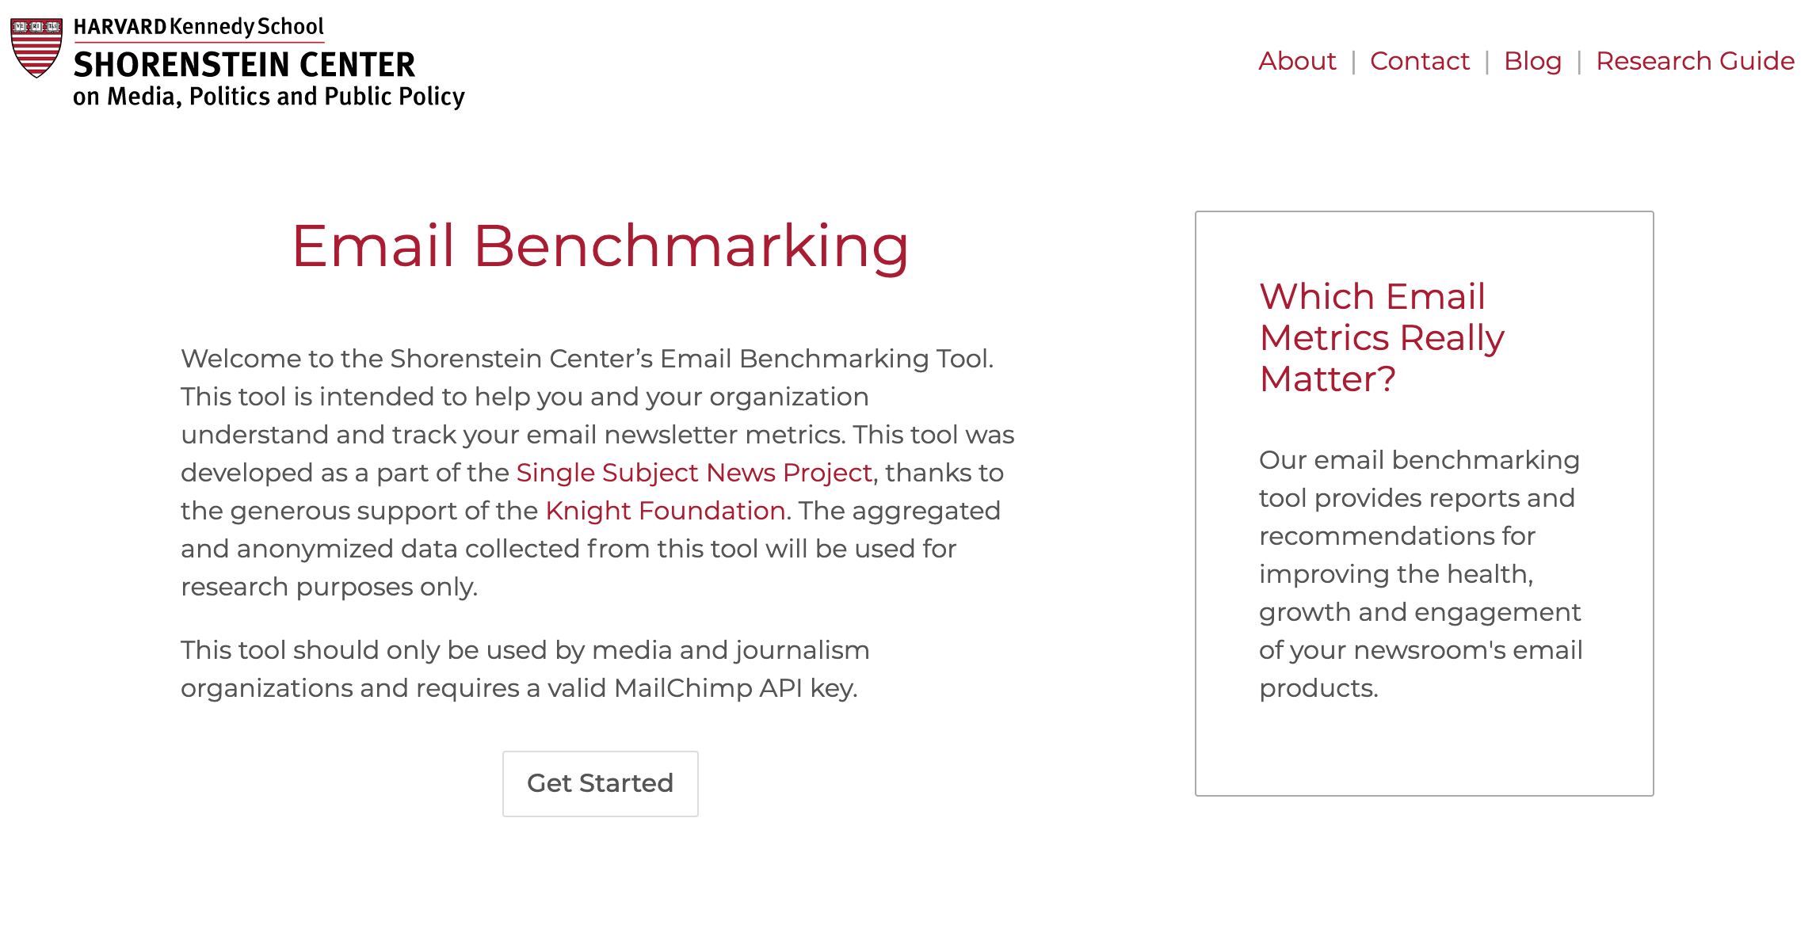
EmailBenchmarking.com

Slide 14
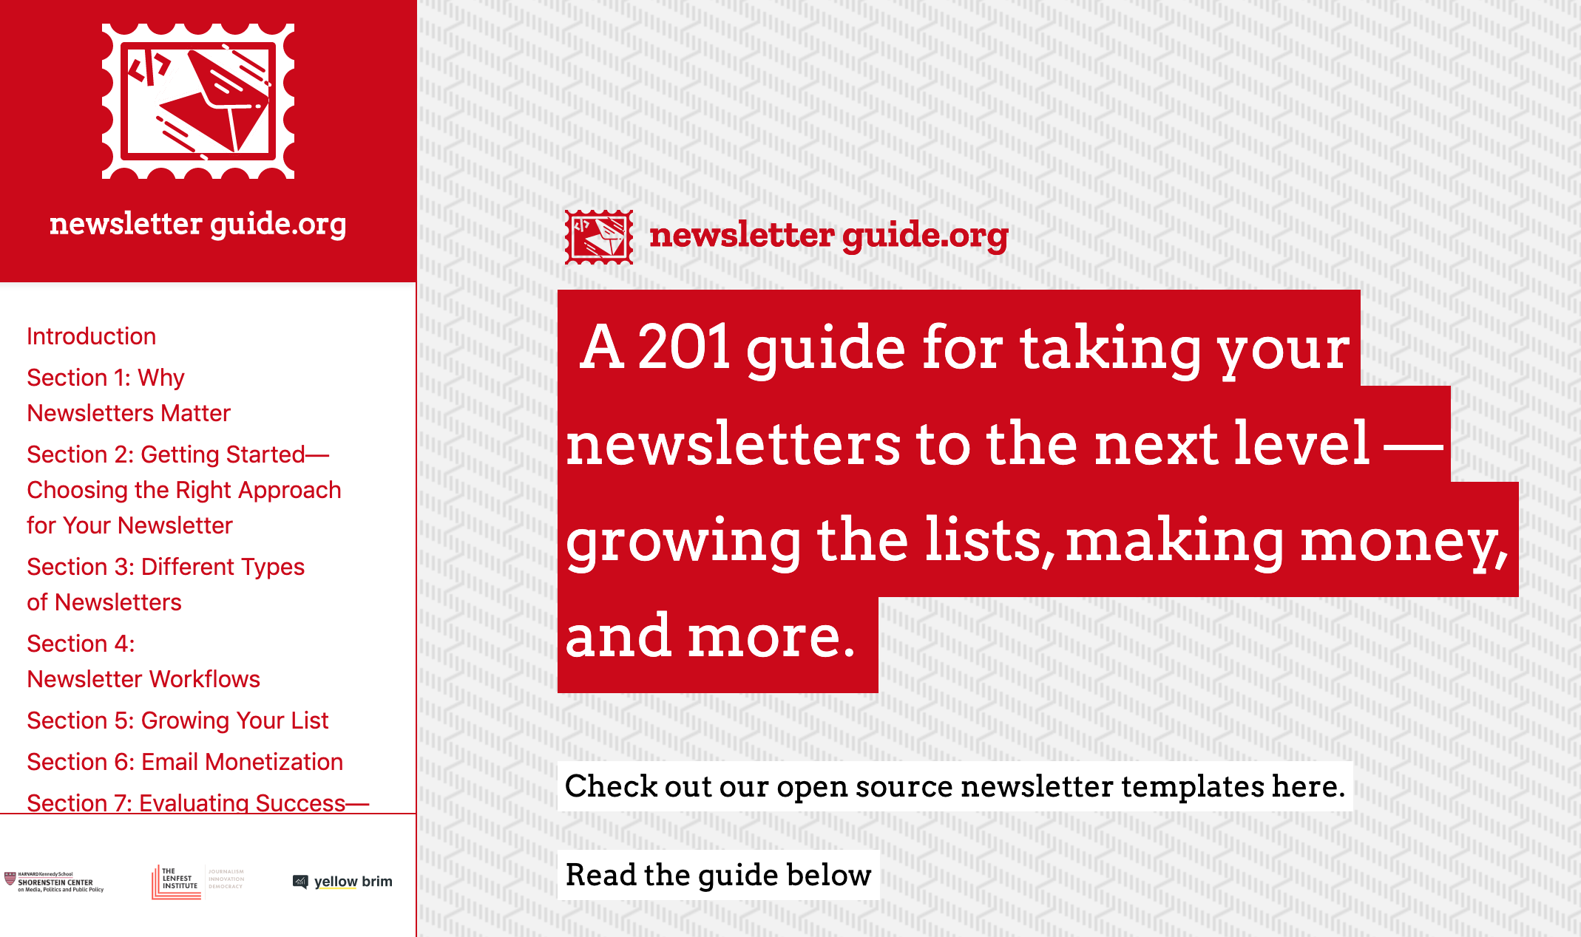
NewsletterGuide.org

Slide 15
METER

Slide 16
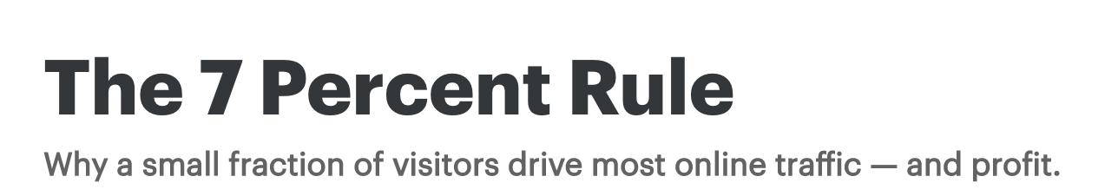
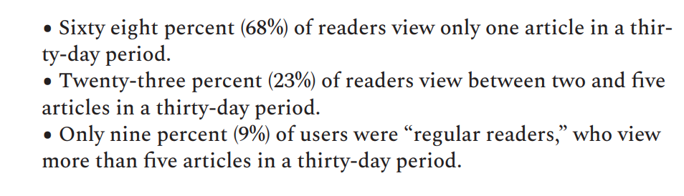
http://bit.ly/kendoctor7
http://bit.ly/niccometer

Slide 17
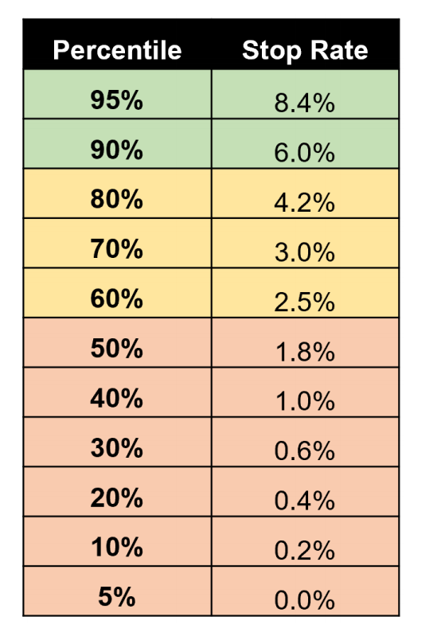
TIGHT METERS

Slide 18
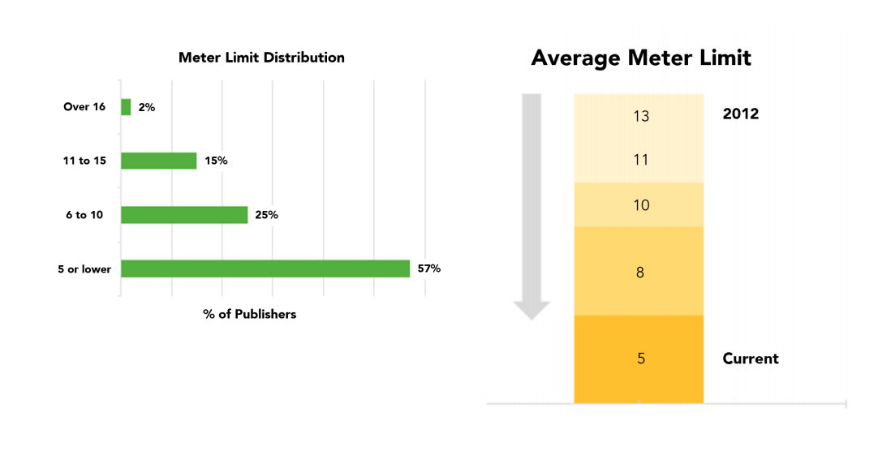

Slide 19
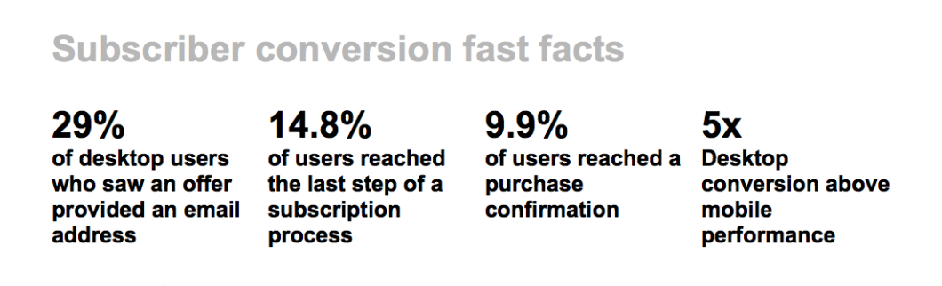
EMAIL, EMAIL, EMAIL

Slide 20
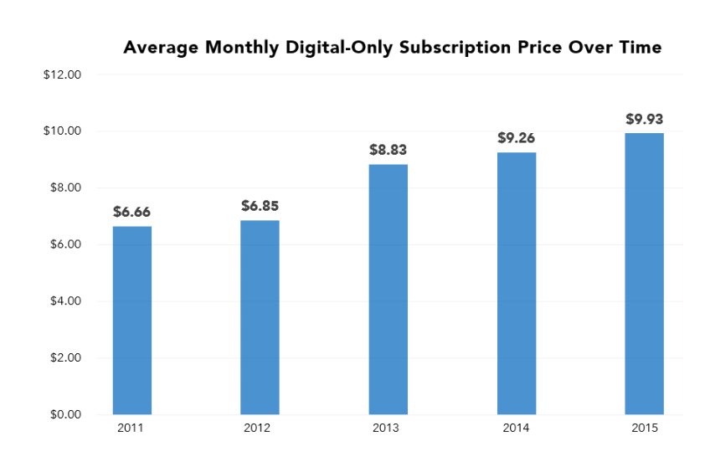
PRICES RISING

Slide 21
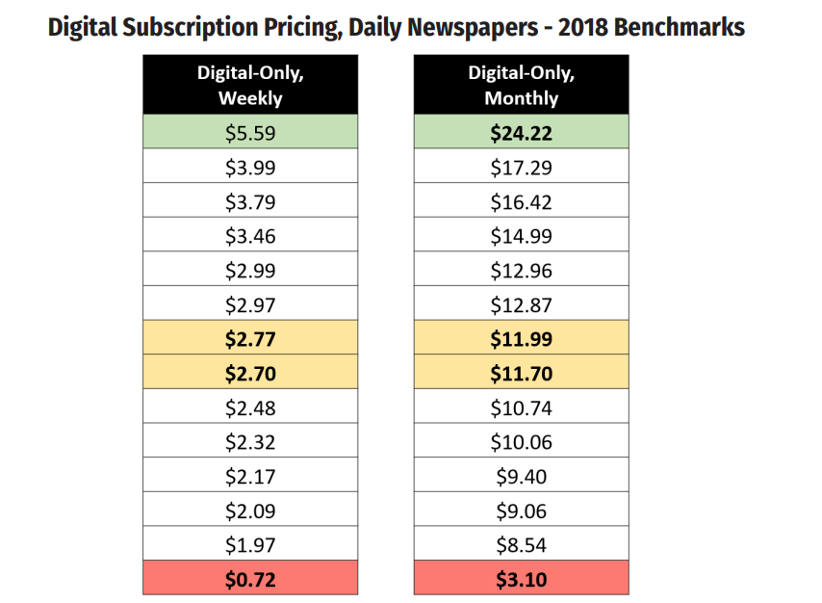

Slide 22
BIGGEST HURDLE?

Slide 23
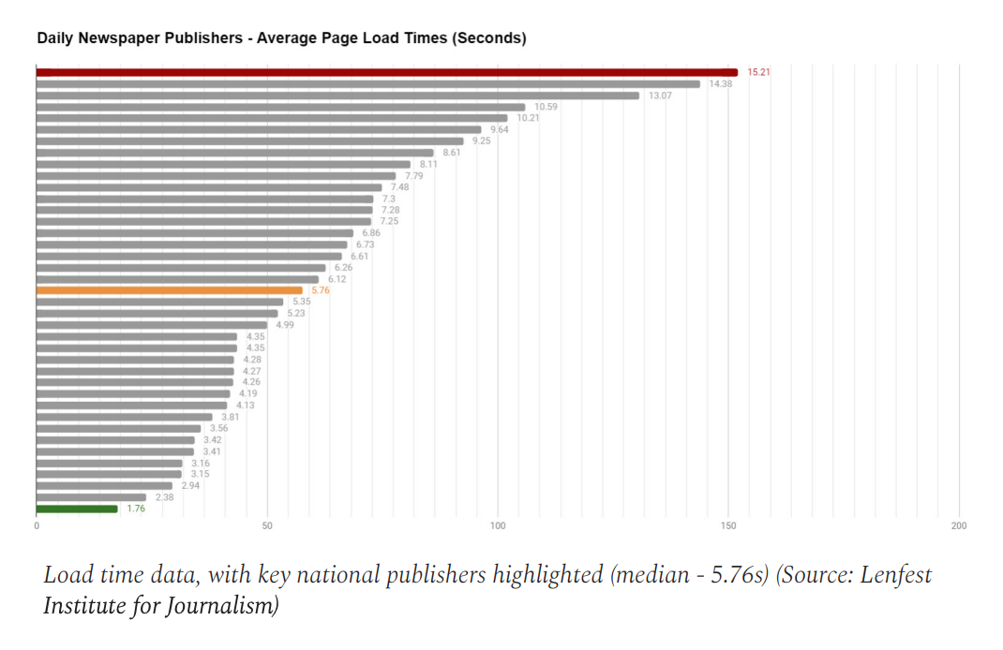

Slide 24
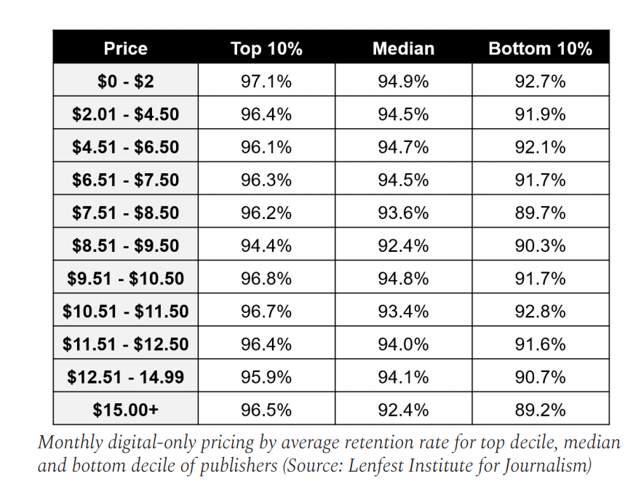
CHURN

Slide 25
Future of Local News
Increase digital circ
Develop new audience-aware editorial products
Tighter your meter
Focus on funnel & email
Value of print – reimagine print
Rethink advertising
Build events business
Consider other vehicles

Slide 26
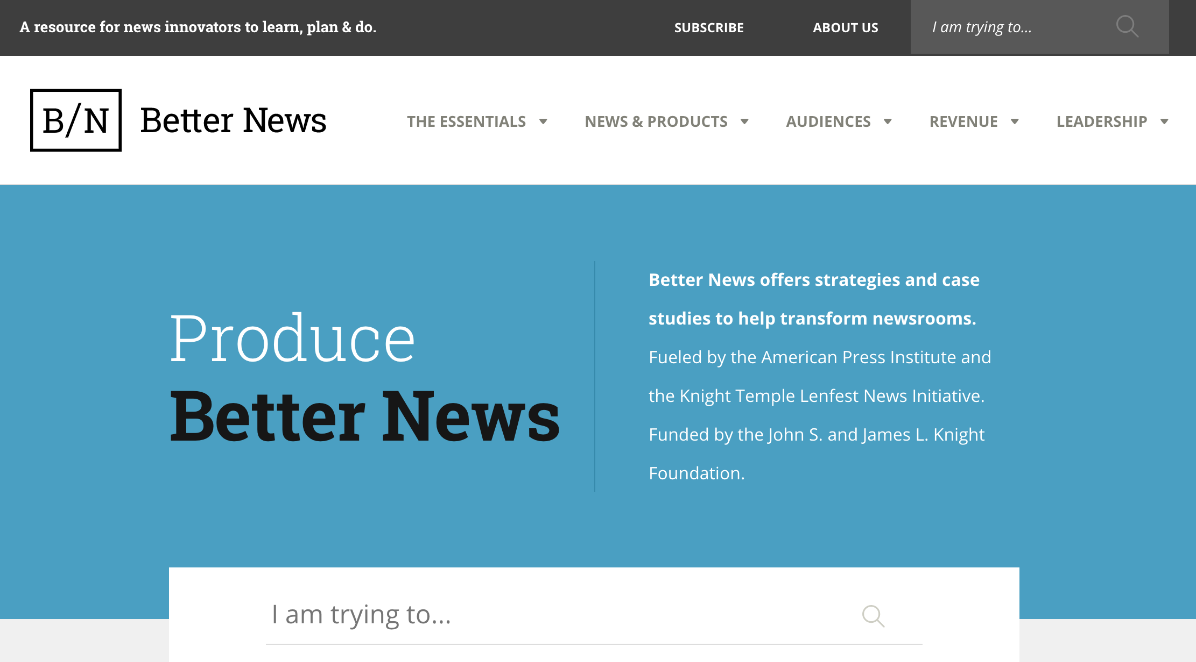

Slide 27

http://bit.ly/niccononprofit

Slide 28
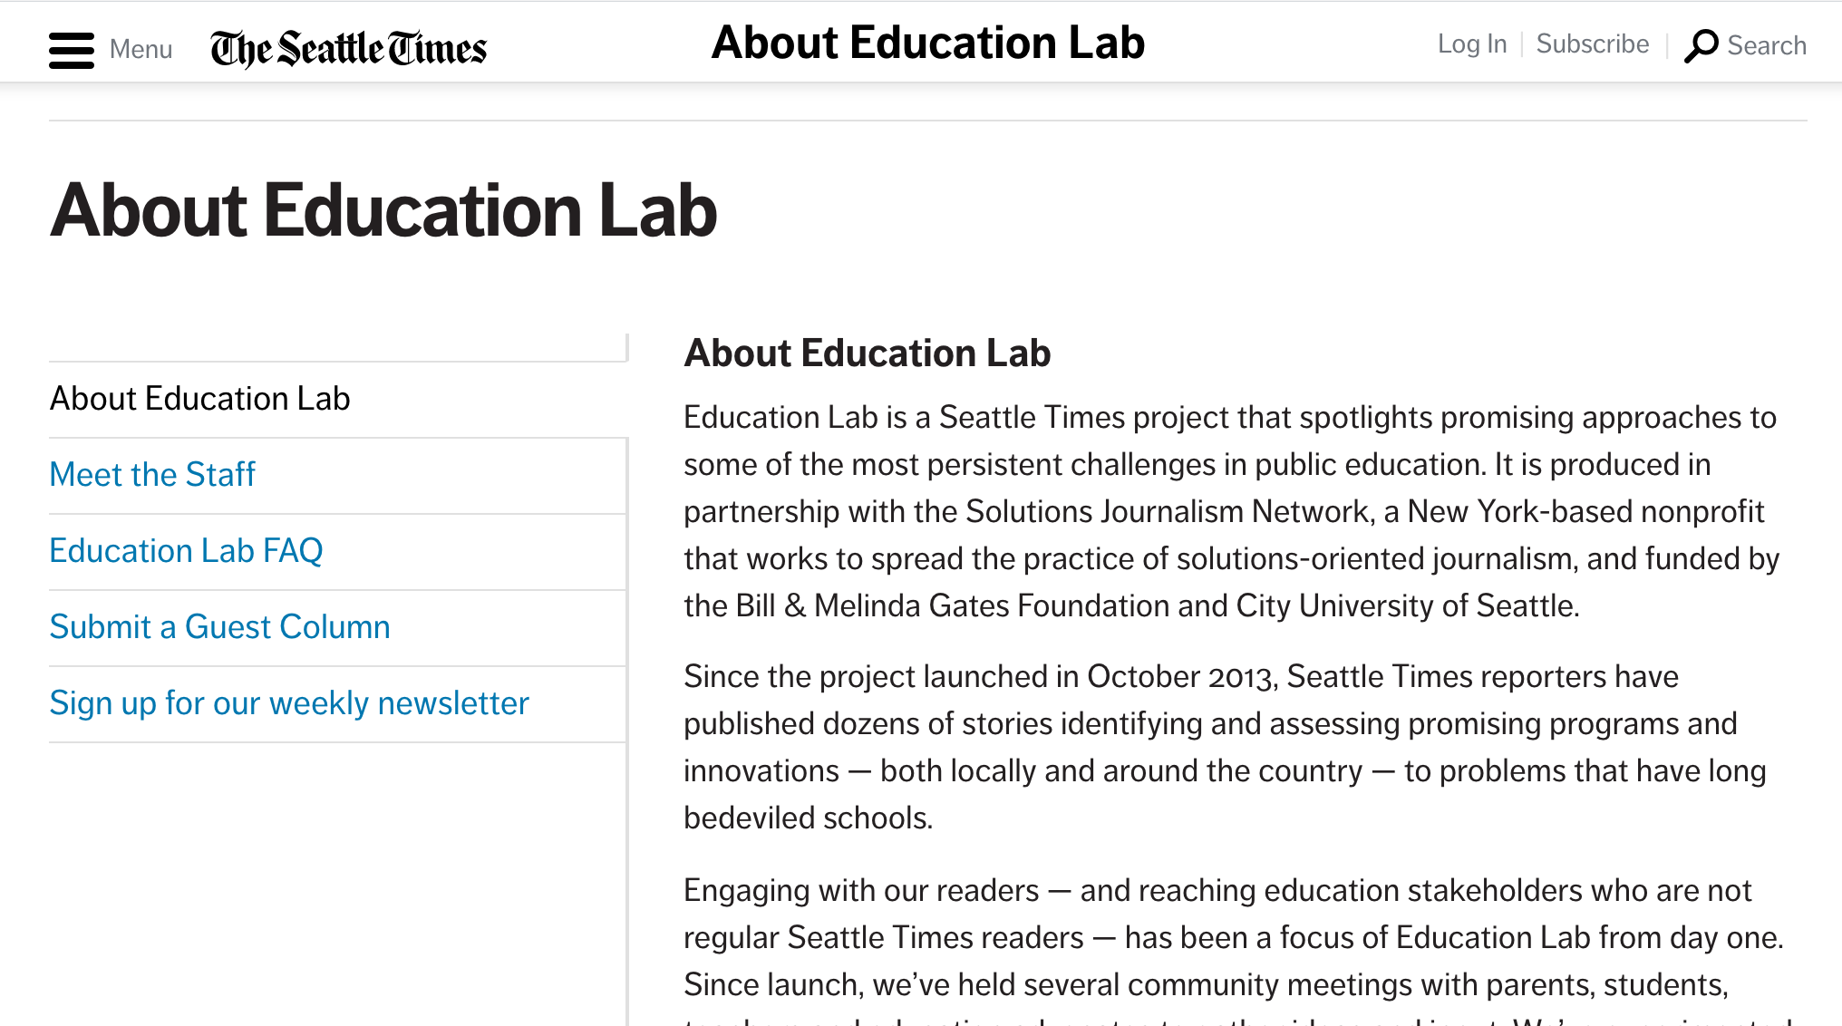

Slide 29
Challenges
Risk Capital
Talent Pipeline
Role of digital platforms

Slide 30

Thank You
Nicco Mele
Faculty, Shorenstein Center on Media, Politics and Public Policy
Harvard Kennedy School
nicco_mele@hks.harvard.edu
office +1.617.496.2582
mobile +1.646.942.7601
@nicco

Slide 31
Online Success
Off-line Product
Big Email List
Online Community

Slide 32
Building Online Success
Online Community
Off-line Product
Big List
Organization
Infrastructure
Innovation

Slide 33
Publisher
Editor
Legal
CRO
Newsroom
Ad Sales
Circulation

Slide 34
New Org Chart required:
Editorial
Tech
Revenue

Slide 35
Email as an example
Editorial – voice, curation, reporting, writing, editing
Revenue – audience that interests advertisers
Tech – production, deliverability
Analytics – shared across all three
Acquisition – shared across all three

Slide 36
Building Online Success
Organization
Infrastructure
Innovation
Small, flat teams
Use of volunteers
Content production
Testing-driven culture
Webtools
Data
Analytics
Early & Often – speed & volume
Test, test, test
Aggressive segmentation
Risk tolerance

Slide 37


